Slide 1
Anglia jest super!!!
Wykonali:
Dominik Kozłowski
Monika Drężek
Julia Nasiadka
Michał Pieńkos
Zuzanna Kulas
Klaudia Wróblewska
Artur Ruszczyk

Slide 2

England is a country that is part of the United Kingdom. It is one of the world’s most popular visitor destinations with lots of tourist attractions. These attractions include amusement and theme parks, castles, palaces, museums, galleries, churches, historic sites and many other. We would like to present some of the most interesting places in England.

Slide 3
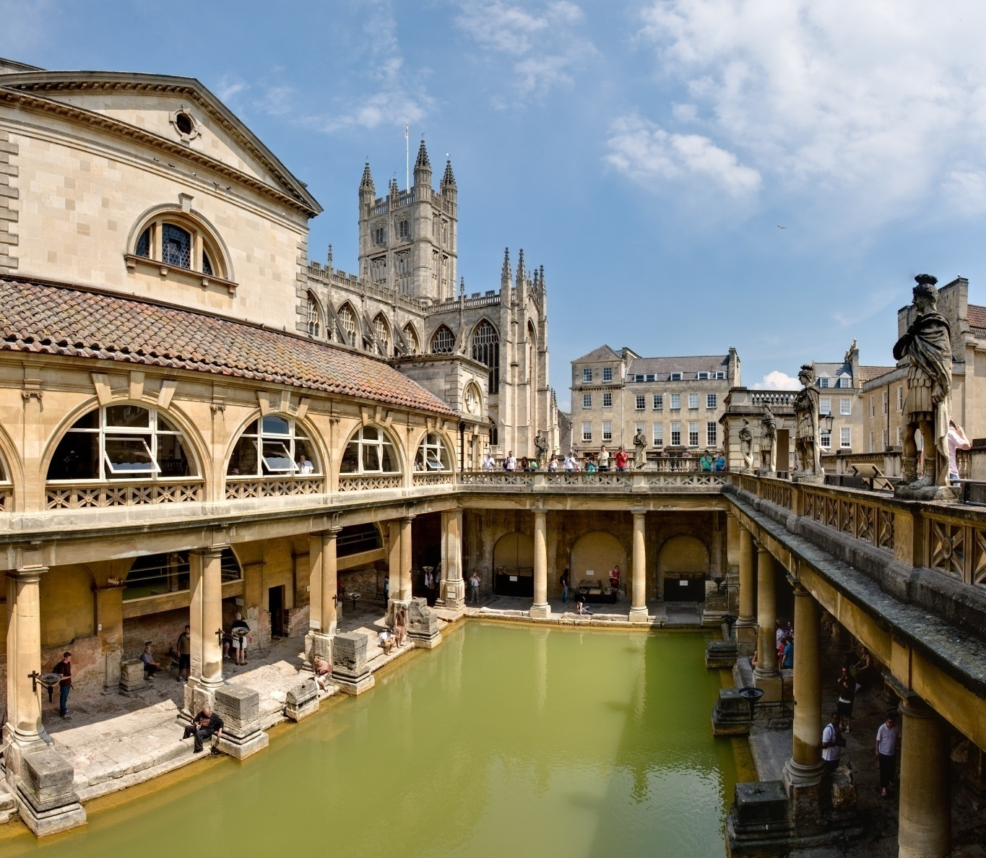
The Roman Baths

Slide 4
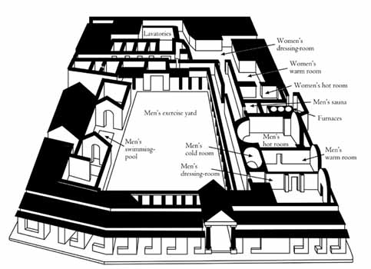
The Roman Baths complex is a site of historical interest in the English city of Bath. The house is a well-preserved Roman site for public bathing. The Roman Baths themselves are below the modern street level. There are four main features: the Sacred Spring, the Roman Temple, the Roman Bath House and the Museum holding finds from Roman Bath. The buildings above street level date from the 19th century.

Slide 5
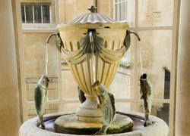
The Baths are a major tourist attraction and, together with the Grand Pump Room, receive more than one million visitors a year. It was featured on the 2005 TV program Seven Natural Wonders as one of the wonders of the West Country. Visitors can see the Baths and Museum but cannot enter the water. An audio guide is available in several languages.
Pump Room fountain

Slide 6
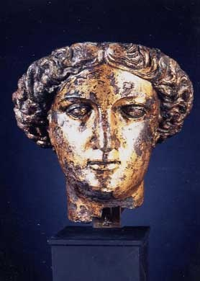
The Roman Baths Museum contains many objects of interest, including thousands of objects thrown into the spring as offerings to the goddess.
These offerings include:
Over 12,000 Roman coins, the largest votive deposit known from Britain;
Curses, with messages inscribed on sheets of lead or pewter that were rolled up and thrown into the spring where the spirit of the goddess dwelt; and
Metal pans known as paterae, inscribed with the letters DSM or the words Deae Sulis Minerva. These may have been used for making offerings of holy water.

Slide 7
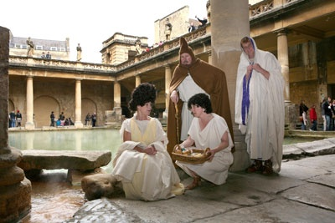
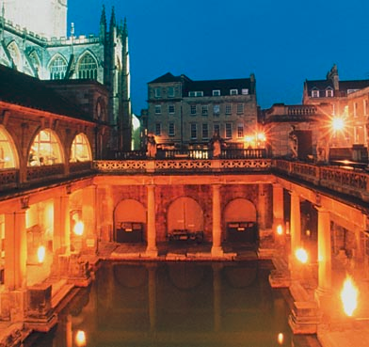
Everyone should see the Roman Baths complex. You can meet Roman costumed characters every day and hear the stories of those who lived and worked here 2,000 years ago. Audioguides in 8 languages, with a special one for children in English and French, are included in the admission price. Enjoy morning coffee, lunch or afternoon tea in the magnificent 18th century Pump Room, accompanied by music from the Pump Room Trio, and try a glass of Spa water from the fountain.

Slide 8
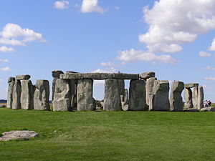
Stonehenge

Slide 9
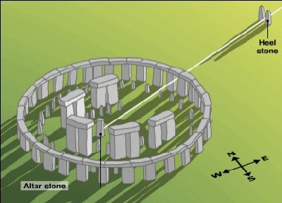
Stonehenge is a prehistoric monument located in the English county of Wiltshire, about 2.0 miles west of Amesbury and 8 miles north of Salisbury. One of the most famous sites in the world, Stonehenge is composed of a circular setting of large standing stones set within earthworks. It is at the centre of the most dense complex of Neolithic and Bronze Age monuments in England, including several hundred burial mounds.

Slide 10
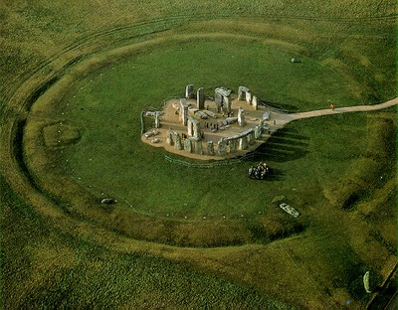
The surrounding circular earth bank and ditch, which constitute the earliest phase of the monument, have been dated to about 3100 BC. The site and its surroundings were added to the UNESCO's list of World Heritage Sites in 1986 in a co-listing with Avebury Henge monument. It is a national legally protected Scheduled Ancient Monument. Stonehenge is owned by the Crown and managed by English Heritage, while the surrounding land is owned by the National Trust.

Slide 11
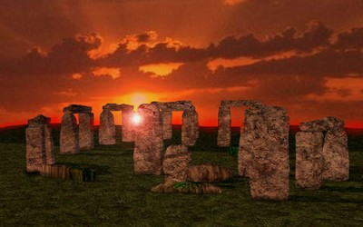
While visiting Stonehenge don't Miss:
-The complimentary audio tour and learn more about the mysteries surrounding Stonehenge.
-The superb shop for unusual gifts souvenirs of your visit to Stonehenge.
-A walk in the prehistoric landscape around Stonehenge to see some of the other monuments in the World Heritage Site.

Slide 12
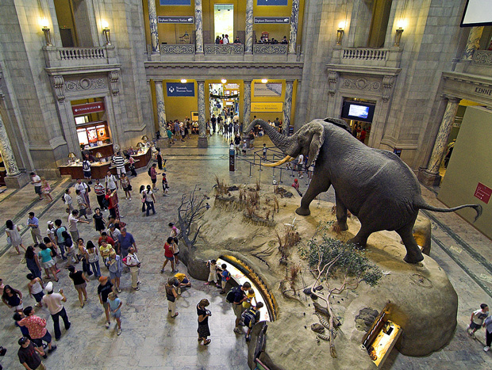
The Natural History Museum

Slide 13
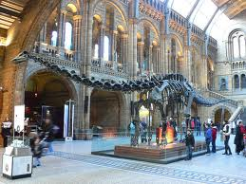
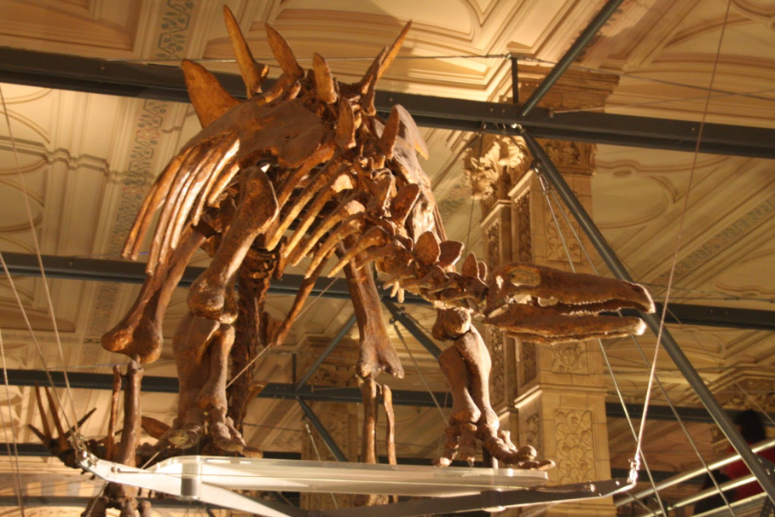
The Natural History Museum is home to one of the largest natural history collections in the world from microscopic slides to mammoth skeletons. The building itself is impressive with cathedral like structure, frescoes and sculptures and the central hall is home to an astounding Diplodocus skeleton.
Most young boys make a pilgrimage to the museum just to see the dinosaur exhibits but there are numerous daily activities, behind-the scenes tours and you can borrow an explorer backpack complete with binoculars and hat!

Slide 14
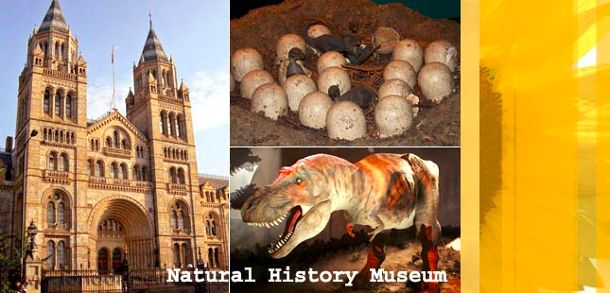
The museum is divided into four coloured zones. The green zone concentrates on facts about life, the planet, environment and evolution. The red zone explores our ever changing planet, how it was shaped and its place within the universe. In the blue zone you can marvel at the diversity of life on our planet from blue whales to the smallest invertebrates. Finally the orange zone takes you into the Wildlife garden and to the Darwin centre.

Slide 15
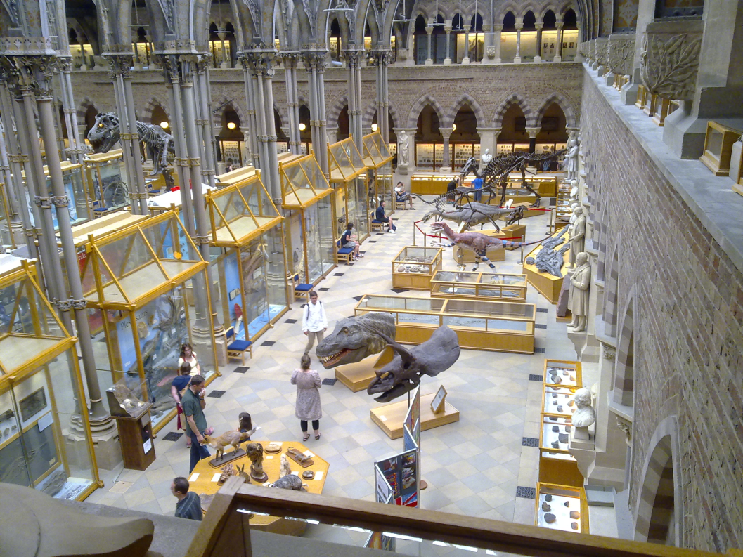
The museum runs a series of educational and public engagement programmes. These include for example a highly praised "How Science Works" hands on workshop for school students demonstrating the use of microfossils in geological research.
The museum also played a major role in securing designation of the Jurassic Coast of Devon and Dorset as a UNESCO World Heritage site and has subsequently been a lead partner in the Lyme Regis Fossil Festivals. In 2010 a six-part BBC documentary series was filmed at the museum entitled Museum of Life exploring the history and behind the scenes aspects of the museum.

Slide 16
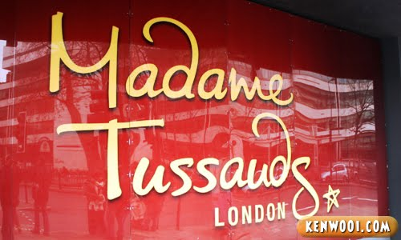
Madame Tussauds

Slide 17
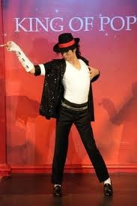
Madame Tussauds is a wax museum in London with branches in a number of major cities. It was founded by wax sculptor Marie Tussaud. Madame Tussauds is a major tourist attraction in London, displaying waxworks of historical and royal figures, film stars, sports stars and famous murderers.
Madame Tussauds contains wax models of famous people. There are numerous galleries such as Pirates of the Caribbean, World leaders, Warhol's women The Royal Family, Sports Stars, the Culture zone and the History of London. There are interactive tasks such as entering the Big Brother diary room, umpiring an Andy Murray tennis match or taking a penalty alongside David Beckham.

Slide 18
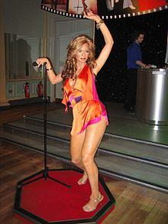
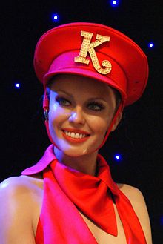
You can have your picture taken alongside A - list celebrities like Drew Barrymore, Orlando Bloom, Nicole Kidman and Leonardo Di Caprio.
For something a little scarier try visiting the Chamber gallery where serial killers lurk. The music zone represents legends of pop from Bob Marley through to current chart toppers Kylie and Justin Timberlake. Visitors are encouraged to try out their own dance moves to see if they can win an award. Or choose a track to perform, and listen to expert feedback on your talent from The X Factor judges.

Slide 19
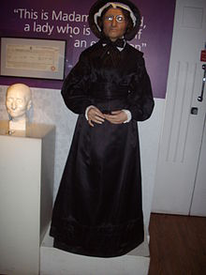
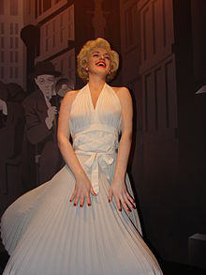
One of the attractions is the Spirit of London sit-down ride in which visitors sit in London taxis and are taken on a journey through the history of London. The ride starts in Tudor times and ends in the 1980s, passing through the times of Shakespeare, the Great Fire of London, the Industrial Revolution and the Swinging Sixties. The ride has commentary in a few languages and a photo is taken near the end of the ride which can be purchased when disembarked.

Slide 20
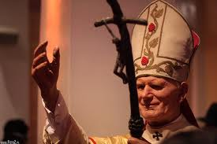
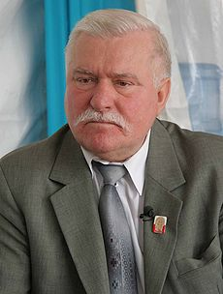
The only Poles, whose characters are in the museum, a Nobel Prize winner Lech Walesa and Pope John Paul II.

Slide 21
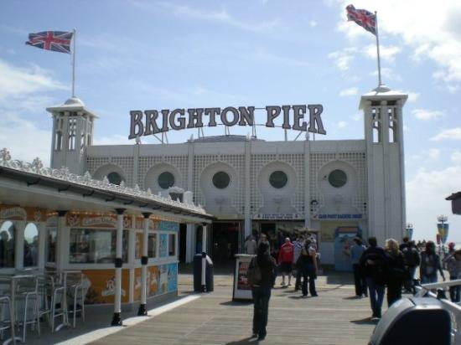
BRIGHTON PIER

Slide 22

The Brighton Marine Palace and Pier is a pleasure pier in Brighton, England. It is generally known as the Palace Pier for short, but has been informally renamed Brighton Pier since 2000. Brighton Pier is one of the best family entertainment destinations in Britain. It has all the latest video games, thrill rides and retail shops to ensure that our customers experience the best of seaside entertainment. With three bars, over thirty food kiosks, traditional seaside stalls, two amusement arcades, rides for all the family, a world famous fish & chip restaurant, and even its own radio station.

Slide 23
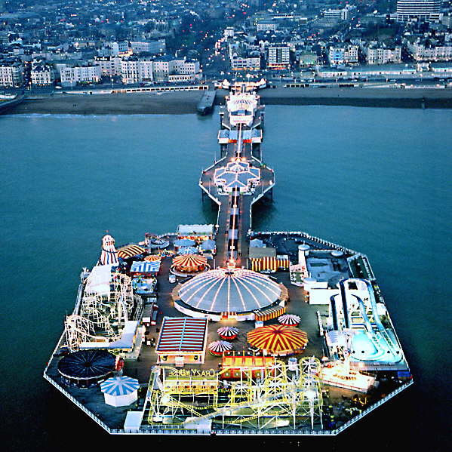
Brighton Pier is one of the oldest and most impressive piers in the UK. Brighton's famous landmark has evolved into a destination in its own right – a waterfront theme park with rides, restaurants, arcades and activities. Much of Brighton Pier's original Victorian charm remains intact. You'll find old kiosks, filigree ironwork and even a cannon from the Chair Pier.Today, Brighton Pier is 1,722 feet of fun! A wonderful combination of traditional British architecture and lively modern entertainment.

Slide 24
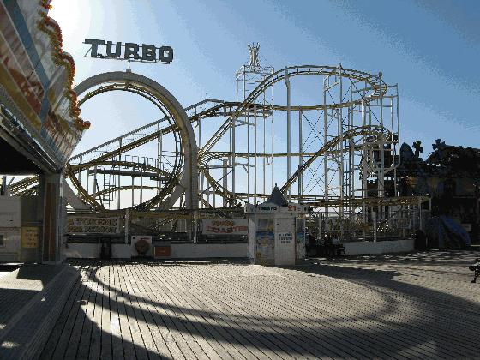
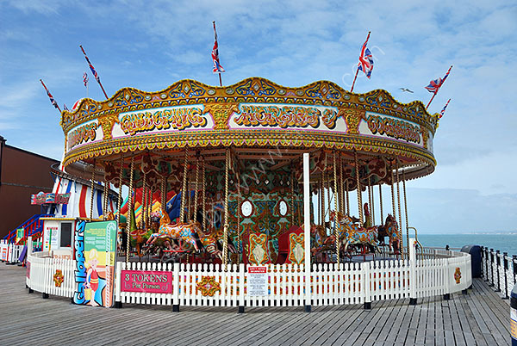
The pier features prominently in the 1971 film, Carry On at Your Convenience, and it is frequently shown iconically to "set" film and television features in Brighton. Much earlier on in 1896 the pier was also shown in many silent films. R.W. Paul shot the iconic film, On Brighton Beach. In 2010, the Palace Pier was the setting for part of an episode of Midsomer Murders, "The Sword of Guillaume". The pier also featured heavily in the TV series Sugar Rush.

Slide 25
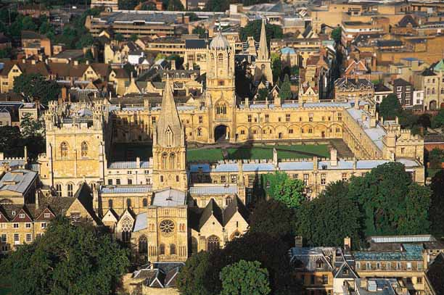
The University of Oxford

Slide 26

The University of Oxford is the second-oldest surviving university in the world and the oldest in the English-speaking world. Although its exact date of foundation is unclear, there is evidence of teaching as far back as 1096. In the 2011 Times Higher Education World University Rankings, Oxford placed fourth in the world and first in Europe. In the 2011 QS World University Rankings Oxford University placed fifth in the world (while Cambridge University came first), rising from sixth in the 2010 rankings.

Slide 27
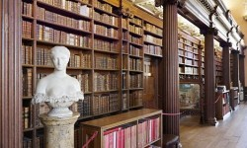
Oxford has 102 libraries, of which 30 belong to the Bodleian Library group, Oxford's central research library. Almost all of Oxford's libraries share a common catalogue, the Oxford Libraries Information System, though with such a huge collection, this is an ongoing task. Oxford University Library Services, the head of which is Bodley’s Librarian, is the governing administrative body responsible for libraries in Oxford.
The list of Polish associated with Oxford includes Radosław Sikorski, Maria Antonina Czaplicka, Maciej Giertych, Urszula Gacek and Adam Zamoyski.

Slide 28
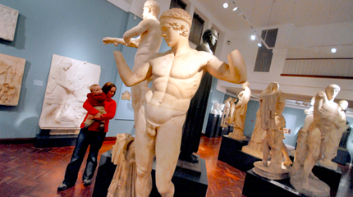
Oxford maintains a number of museums and galleries in addition to its libraries. The Ashmolean Museum, founded in 1683, is the oldest museum in the UK, and the oldest university museum in the world. It holds significant collections of art and archaeology, including works by Michelangelo, Leonardo da Vinci, Turner, and Picasso, as well as treasures such as the Scorpion Macehead, the Parian Marble and the Alfred Jewel.

Slide 29
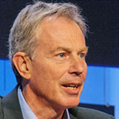
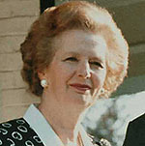
There are many notable Oxonians. Twenty-six British prime ministers have attended Oxford Harold Wilson, Margaret Thatcher, Tony Blair and most recently David Cameron. At least thirty other international leaders have been educated at Oxford.
The long list of writers associated with Oxford includes Samuel Johnson, Oscar Wilde, C. S. Lewis, J. R. R. Tolkien, Graham Greene and Phillip Pullman. Actors Hugh Grant, Kate Beckinsale, Dudley Moore, Michael Palin and Terry Jones were undergraduates at the University, as were Oscar-winner Florian Henckel von Donnersmarck and film-makers Ken Loach and Richard Curtis.
Tony Blair
Margaret Thatcher

Slide 30
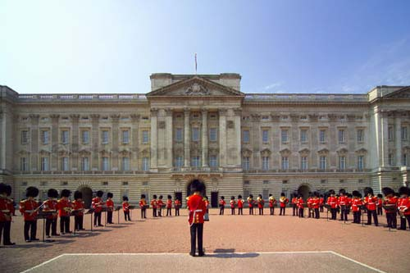
Buckingham Palace

Slide 31
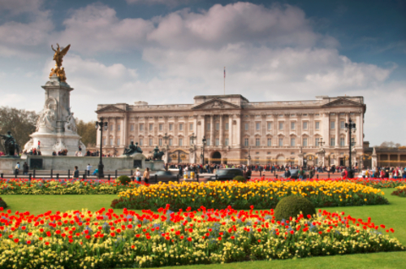
Buckingham Palace is the Queen's official London residence and is used to receive and entertain guests on state, ceremonial and official occasions for the Royal Family. The palace was originally built in 1705 for the Duke of Buckingham.
The Palace is located between The Green Park, Hyde Park and St. James's Park.

Slide 32
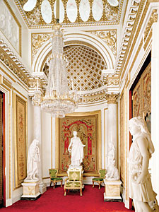
Buckingham Palace is like a small town, with a police station, two post offices, a hospital, a bar ,two sports clubs, a disco, a cinema and a swimming pool. There are 600 rooms and three miles of red carpet. Two men work full-time to look after the 300 clocks. About 700 people work in the Palace.
It is two places, not one. It is a family house, where children play and grow up .It is also the place where presidents, kings and politicians go to meet the Queen.

Slide 33
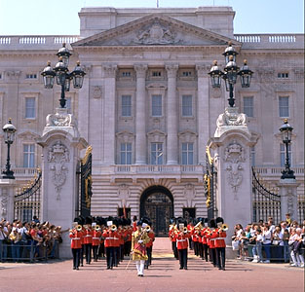
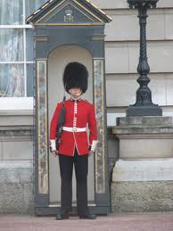
One of the most interesting sight is the Changing of the Guard. There are always guardsmen- and policemen too - outside the Palace. Every day a new guard of thirty guardsmen marches to the Palace and takes the place of the old guard. This is one of the most popular sights for tourists in London. First the band marches through the gates of the Palace. The job of the police is to stop the tourists from following the guards! Then the rest of the new guard marches through the gates. The guardsmen wear traditional uniform: a red coat and a black helmet. The helmet is called a ‘bearskin’ and it’s made of fur.

Slide 34
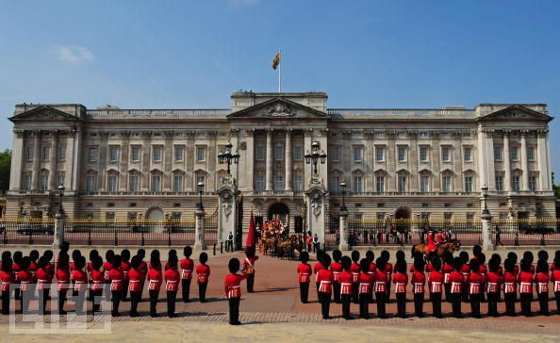
London has many traditions like the Changing of the Guard and many sights for the tourist to see. Buckingham Palace is just one of them.

Slide 35
THE END

